Slide 1
ANALYZE SURVEY DATA
-AMLAN JYOTI SAIKIA
N.B- The data collected is only from the respondents, the results may vary for the entire population.

Slide 2
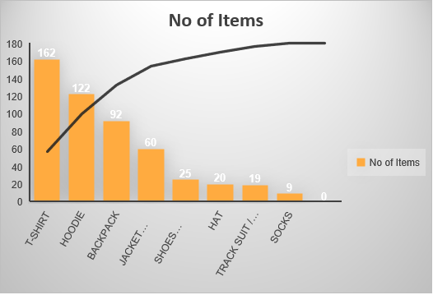
Which item appealed the most?
The pareto chart on the left side gives the no of items which appealed the most from the swag store. The most wanted item was t-shirt at 162 no’s. Hoodie was second best option at 122. The third wanted item was backpack at 92. Followed by jacket at 60. Shoes was at 25. Tracksuit and hat was both at 19 and 20 respectively. The least wanted item was sock at 9.

Slide 3
How many hours per week on learning?
The highest hours spent on learning was six hours per week, while the lowest hours spend on learning was 1 hour per week. The range of hours that students learned was found out to 5. The average hours spent on learning was calculated to be 4.75. The Standard Deviation was calculated to be 1.303.The highest hour being 4.7 hours away from standard deviation, while the lowest value being .303 hours away from the standard deviation. The more higher difference from the standard deviation proves that 6 is the maximum value. The mode of the data was found to be 6, i.e. out of all particular hours 6 has the maximum number of students out of all hours. The first quartile of the data 4 and the third quartile of the dataset was found to be 6. This proves that maximum hours spent on learning by students was between 4 to 6 hours per week.

Slide 4
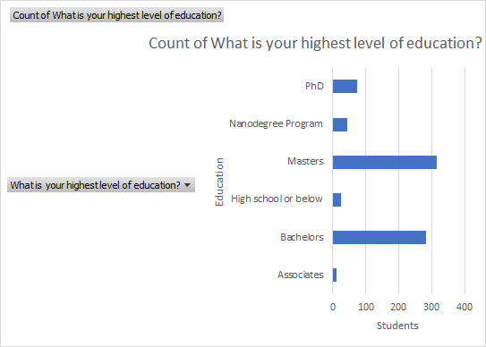
What was the level of education in Nanodegree student?
Here is the bar chart that contains the education qualification of students enrolled in a nanodegree programme. The highest number of students were that of the Masters degree holder, while that the lowest was from the associates. Approx 42% of students belonged to masters. 37.58% percent belonged to bachelors degree. Associates have almost 1.59%. Phd program has almost 9.69%. The other two have percentages less than 10 percentage.

Slide 5
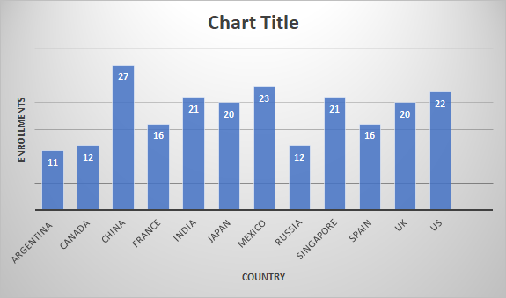
Which country has the highest enrollments in Deep Learning Foundation?
China has 27 enrollments, i.e the highest enrollment in Deep learning Foundation. The average enrollments from these countries are 18.41. 5 countries has value which is less than the mean value. The median of this data is 20. The standard deviation is 4.78. China is almost 22 values different than standard deviation, this makes it the highest value.The mode is 12 which are from Canada and Russia. The highest enrollment is of China i.e 27 and the lowest is of Argentina, i.e 11 this makes the range 16. 3 countries have values less than the range. The difference between China and range is of 11, which makes China the highest value and shows the demand of deep learning in China.
<visualization or summary statistics used for finding>

